Slide 1
Tracking Progress

Slide 2
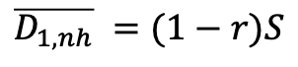
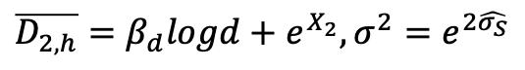
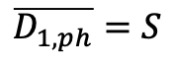
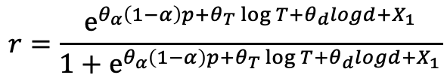
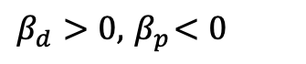
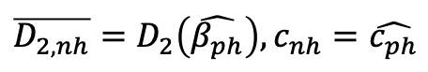
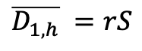
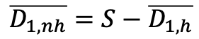
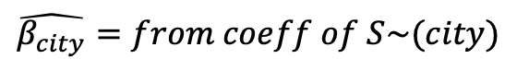
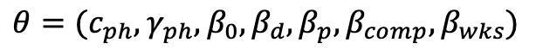
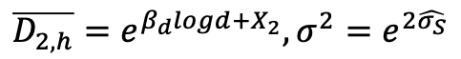
$$\overline{D_{1,ph}}=S$$
$$\overline{D_{2,ph}}=β_{0}+β_{d}\log\left(d\right)+β_{p}\log\left(p\right)+β_{comp}\log\left(competitors\right)+β_{wks}weekends+\hat{β_{city}} city, σ^{2}=e^{2 (\hat{σ_{S}}+γ_{ph}d)}$$
$$\hat{β_{city}}=from coeff of S\sim (city)$$
$β_{d}>0,{ β}_{p}<0$
$$θ=(c_{ph},γ_{ph},β_{0},β_{d},β_{p},β_{comp},β_{wks})$$
$$\overline{D_{1,h}}=θ_{α}\left(1−α\right)p+θ_{T}\log{T}+θ_{d}logd+e^{X_{1}}, σ^{2}=e^{2(\hat{σ_{S}}+γT)}$$
$$\overline{D_{1,h}} =rS$$
$$\overline{D_{1,nh}} =(1−r)S$$
$$\overline{D_{2,h}}=β_{d}logd+e^{X_{2}}, σ^{2}=e^{2\hat{σ_{S}}}$$
$$r=\frac{e^{θ_{α}\left(1−α\right)p+θ_{T}\log{T}+θ_{d}logd+X_{1}}}{1+e^{θ_{α}\left(1−α\right)p+θ_{T}\log{T}+θ_{d}logd+X_{1}}}$$
$$\overline{D_{1,nh}}=S−\overline{D_{1,h}}$$
$$\overline{D_{2,nh}}=D_{2}\left(\hat{β_{ph}}\right), c_{nh}=\hat{c_{ph}}$$
$$\overline{D_{2,h}}=e^{β_{d}logd+X_{2}}, σ^{2}=e^{2\hat{σ_{S}}}$$
$θ_{α}<0,θ_{T}$ per industry (free for now), $θ_{d},β_{d}<0$
$$θ=\left(c_{h},γ,θ_{α},θ_{T},θ_{d},β_{d},X_{1},X_{2}\right), c_{h}≥c_{ph}$$

Slide 3
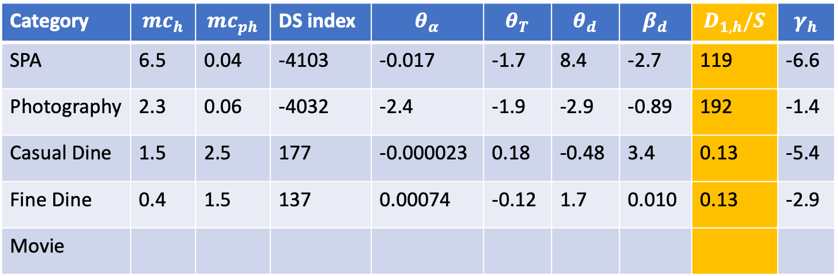
$$DS index= (\frac{{S − D}_{1,h}}{d−l}−\frac{D_{1,h}}{l})−(\frac{S−D_{1,h}\left(α=1,T=0\right)}{d−l}−\frac{D_{1,h}\left(α=1,T=0\right)}{l})$$
Category | $${mc}_{h}$$ | $${mc}_{ph}$$ | DS index | $$θ_{α}$$ | $$θ_{T}$$ | $$θ_{d}$$ | $$β_{d}$$ | $$D_{1,h}/S$$ | $$γ_{h}$$
SPA | 6.5 | 0.04 | -4103 | -0.017 | -1.7 | 8.4 | -2.7 | 119 | -6.6
Photography | 2.3 | 0.06 | -4032 | -2.4 | -1.9 | -2.9 | -0.89 | 192 | -1.4
Casual Dine | 1.5 | 2.5 | 177 | -0.000023 | 0.18 | -0.48 | 3.4 | 0.13 | -5.4
Fine Dine | 0.4 | 1.5 | 137 | 0.00074 | -0.12 | 1.7 | 0.010 | 0.13 | -2.9
Movie
Multiply by mean price to compare across industries

Slide 4
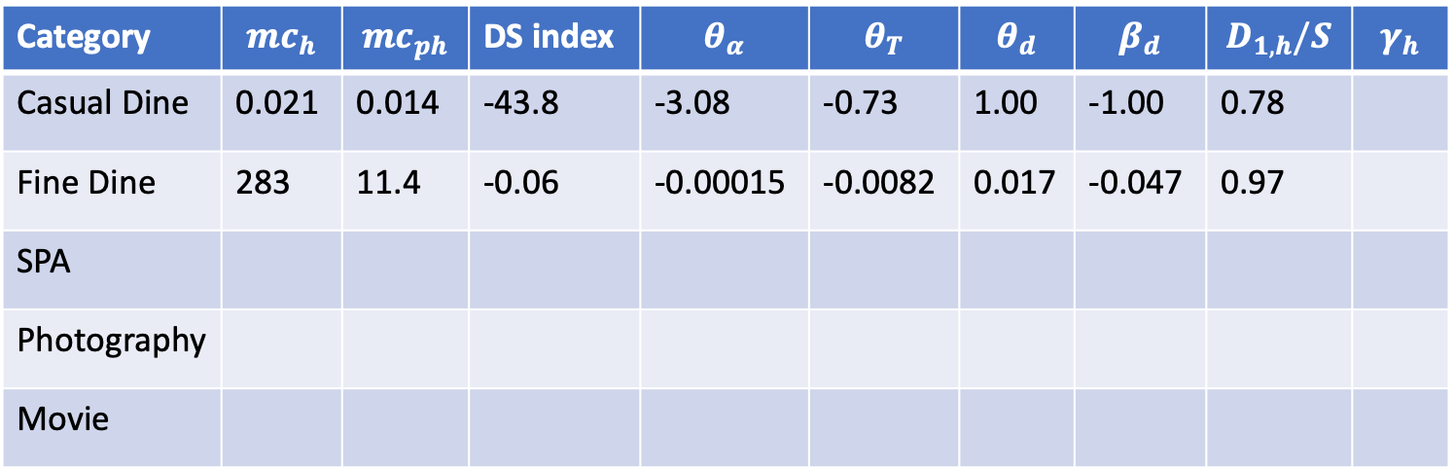
Category | $${mc}_{h}$$ | $${mc}_{ph}$$ | DS index | $$θ_{α}$$ | $$θ_{T}$$ | $$θ_{d}$$ | $$β_{d}$$ | $$D_{1,h}/S$$ | $$γ_{h}$$
Casual Dine | 0.021 | 0.014 | -43.8 | -3.08 | -0.73 | 1.00 | -1.00 | 0.78
Fine Dine | 283 | 11.4 | -0.06 | -0.00015 | -0.0082 | 0.017 | -0.047 | 0.97
SPA
Photography
Movie
Casual dine, holiday, only control for theta_alphap<0

Slide 5
68% non trivial DS

Slide 6
Customer sensitivities

Slide 7
MAPE of optimal deal designs

Slide 8
Marginal costs and demand

Slide 9
Mechanism of deals helping to gain profits
The total demand to serve, indeed increase with the discount services. We modeled full and discount demand to correlate through discount price and T.
We still see total profit boost. Since, except for the demand boost, the online deal also help to reallocation demand across time with the flexible redemption time.

Slide 10
The three operational roles and the industry characteristics
Demand boost and smooth is successful, the variance also indeed decrease with an increase T. Three effects to help with the profit increase. How do we link to the industry characteristics?

